Slide 1

Deep Learning for Anomaly Detection: Challenges, Methods, and Opportunities AML course 2022/23
Alessandro Flaborea | October 28, 2022

Slide 2
Outline
Overview of challenges and methods
Introduction to anomaly detection
Problems and challenges
Deep vs. shallow methods
Overview of deep anomaly detection approaches
Methods
The modeling perspective
The supervision information perspective
Implementation and evaluation
Conclusions and future opportunities
Summary of the methods
PINlab research

Slide 3
Part 1: Overview of Challenges and Methods
Problem definition and applications
Challenges
Deep vs. shallow methods
Overview of deep anomaly detection approaches
Taxonomy of methods

Slide 4
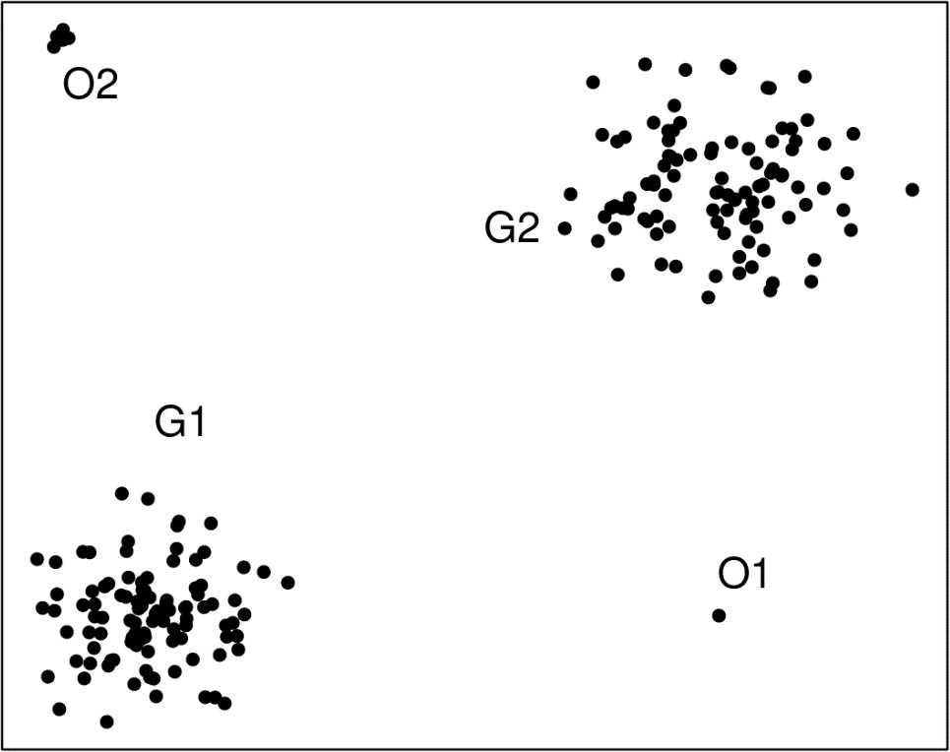

What are Anomalies?
Anomalies (a.k.a., outliers, novelties): Points that are significantly different
from most of the data
Rare
Irregular
Who didn’t see The Office
Image source: Wikipedia

Slide 5
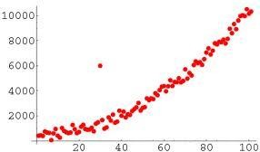
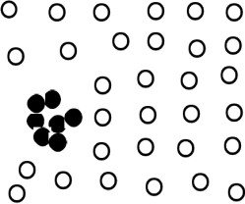
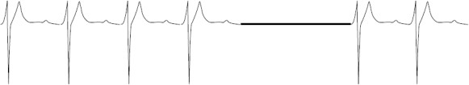
Anomaly detection: Problem Variations
Binary Output versus scoring
Binary output generates a yes/no tag
Preferable and more general: Scoring output generates a real-valued score or rank
Multiple ways to define what makes an anomaly different
Normal Outlier
Conditional anomalies
Point anomalies
Group anomalies
Image source: Gupta et al. CIKM Tutorial 2013

Slide 6


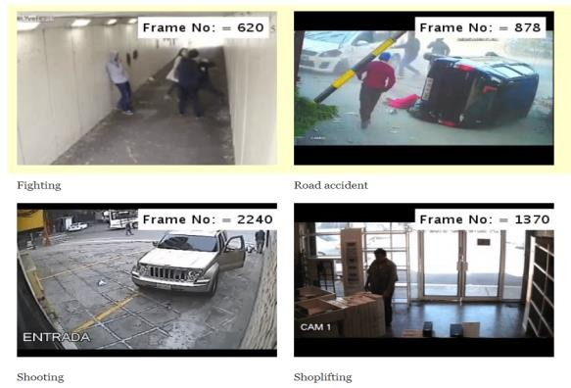
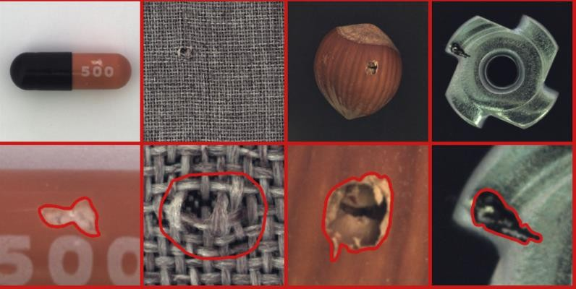

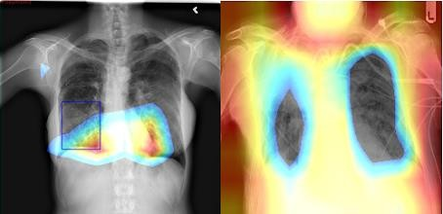
Real-World Application Domains
Cybersecurity:
attacks, malware, malicious
apps/URLs, biometric spoofing
Social Network and Web Security: false/malicious accounts, false/hate/toxic information
Video Surveillance: criminal activities, road accidents, violence, etc.
fighting road accident
shooting shoplifting
Industrial Inspection:
Defects, micro-cracks
Finance:
credit card/insurance frauds, market
manipulation, money laundering, etc.
Healthcare:
lesions, tumours, events in IoT/ICU monitoring, etc.
Image source: UCF-Crime data, MVTec AD data, etc.

Slide 7

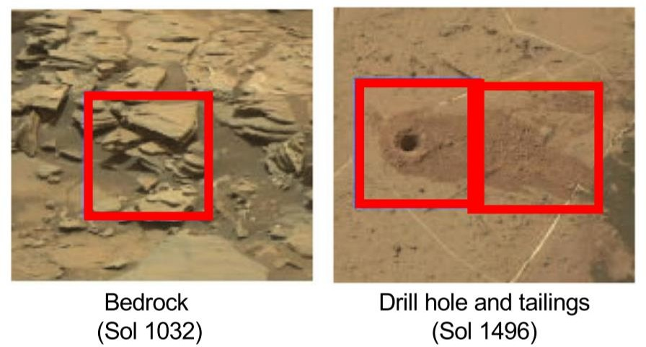
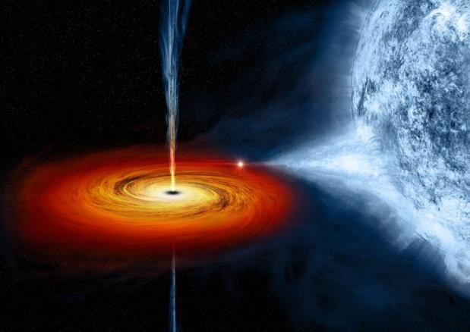
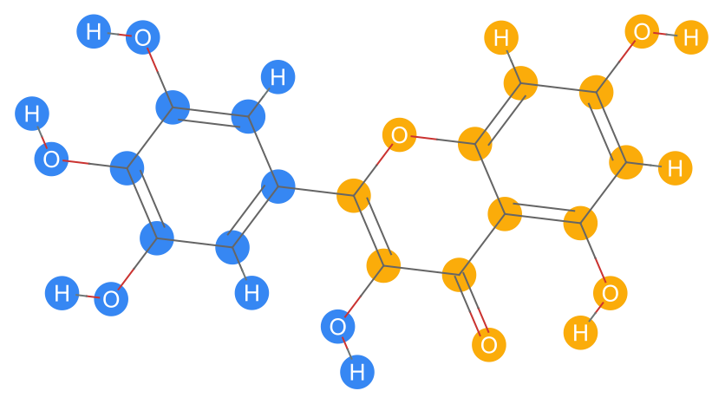
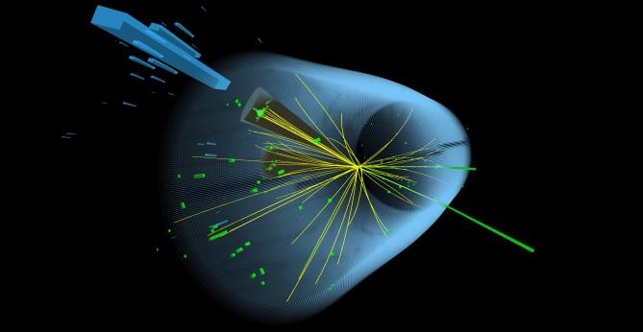
Scientific Application Domains
Drug Discovery:
rare active substances
Rover-Based Space Exploration:
unknown textures
Astronomy:
Anomalous events
Material Science:
exceptional molecule graphs
High-Energy Physics:
Higgs boson particles

Slide 8
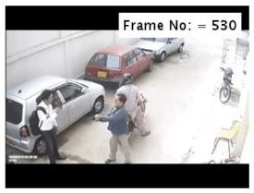
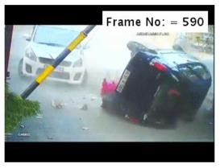
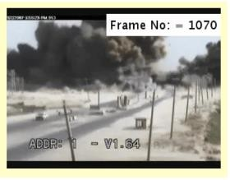
Application-Specific Complexities
Four key complexities
Heterogeneity
Different anomalies may exhibit completely different expressions, e.g., accidents, robbery vs. explosion events
Application-specific methodologies
Different methodologies required by different application-specific definitions, e.g., credit card frauds (point anomalies) vs malicious accounts in social media (group anomalies)
Unknown Nature (unsupervised setting)
Anomalies remain unknown until they actually occur
Coverage
Difficult to collect data covering all classes of anomalies
Robbery
Accidents
Explosion
Source: Wikipedia, UCF-Crime

Slide 9
Key Challenges
1. Low Anomaly Detection Accuracy
Rareness and heterogeneity of anomalies in a dataset
Many returned anomalies are noise or uninteresting instances
2. Contextual and High-Dimensional Data
Anomalies are visible only in context of implicit relations in temporal, spatial and graph data
Increased dimensionality also makes anomaly detection difficult
3. Sample-Efficient Learning
Building generalized detection models with a limited amount of labeled anomaly data

Slide 10
Key Challenges
4. Noise-Resilient Anomaly Detection
Data may contain normal and anomalous instances with no labels (anomaly contamination)
Data may contain weak supervision information:
Coarse anomaly labels such as leveraging video-level labels to detect anomalous frames
5. Complex Anomalies
Conditional/group anomalies
Multi-modal anomalies
6. Anomaly Explanation
Obtaining cues about why a specific instance is detected anomalies by specific methods
Balancing interpretability and detection accuracy

Slide 11
Traditional (Shallow) Methods and Disadvantages
Statistical/probabilistic-based approaches
Statistical test-based, depth-based, deviation-based
Proximity-based approach
Distance-based, density-based, clustering-based
Shallow ML Models
Construct an unsupervised (one-class) analog of a supervised ML model such as the SVM
Use unsupervised dimensionality reduction methods, PCA, kernel PCA
Others
Information-theoretic, subspace methods
Weaknesses
Weak capability of capturing intricate relationships
Lots of hand-crafting of algorithms and features [ad hoc]
Ad hoc nature makes it difficult to incorporate supervision seamlessly

Slide 12
Advantages of Deep Learning
Integrates feature learning and anomaly scoring
Generates newly learned feature space → Auninformative and primitive feature representations [e.g., image pixels]
End-to-end learning → Can simultaneously learn features and relevant anomaly scores [no hand-crafting of features]
Strong feature learning → Captures intricate relations [e.g., mid-level image features]
Diverse neural architectures → Tailor to complex domains [e.g., RNN for time-series]
Unified detection and localization of anomalies → Better anomaly explanation guaranteed by integration of detection and localization
Anomaly-informed models with improved accuracy → Naturally integrates with labeled data (easy to navigate spectrum of supervised and unsupervised models)

Slide 13
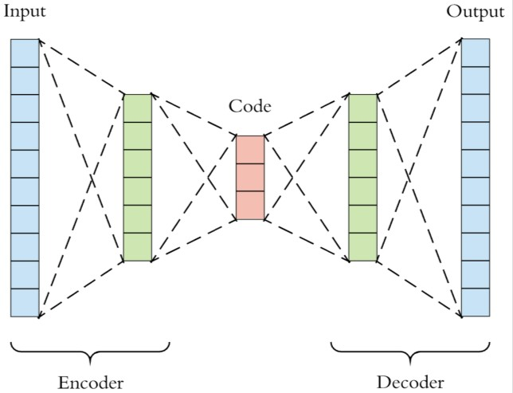
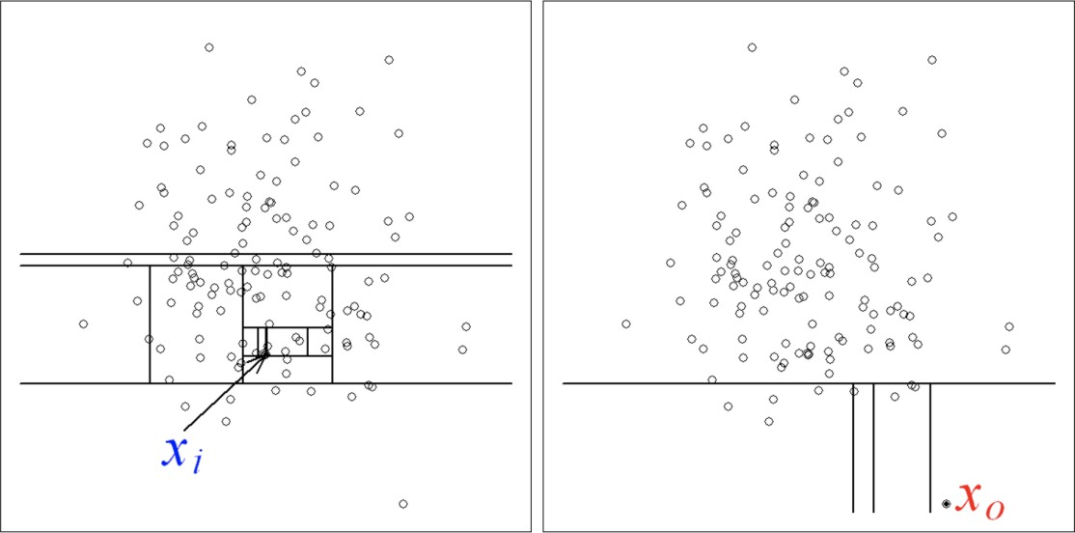
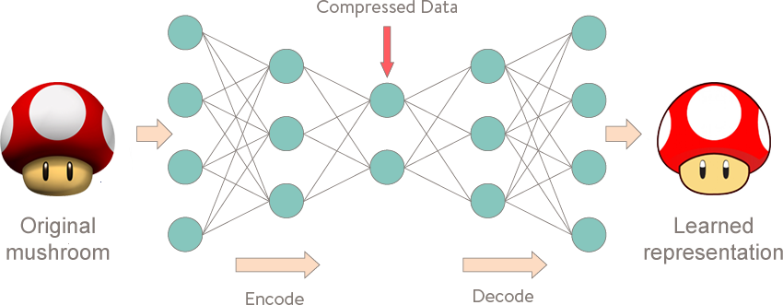
Deep vs Shallow [Traditional]: Example
Deep Method - Autoencoder
Shallow Method – iForest

Slide 14
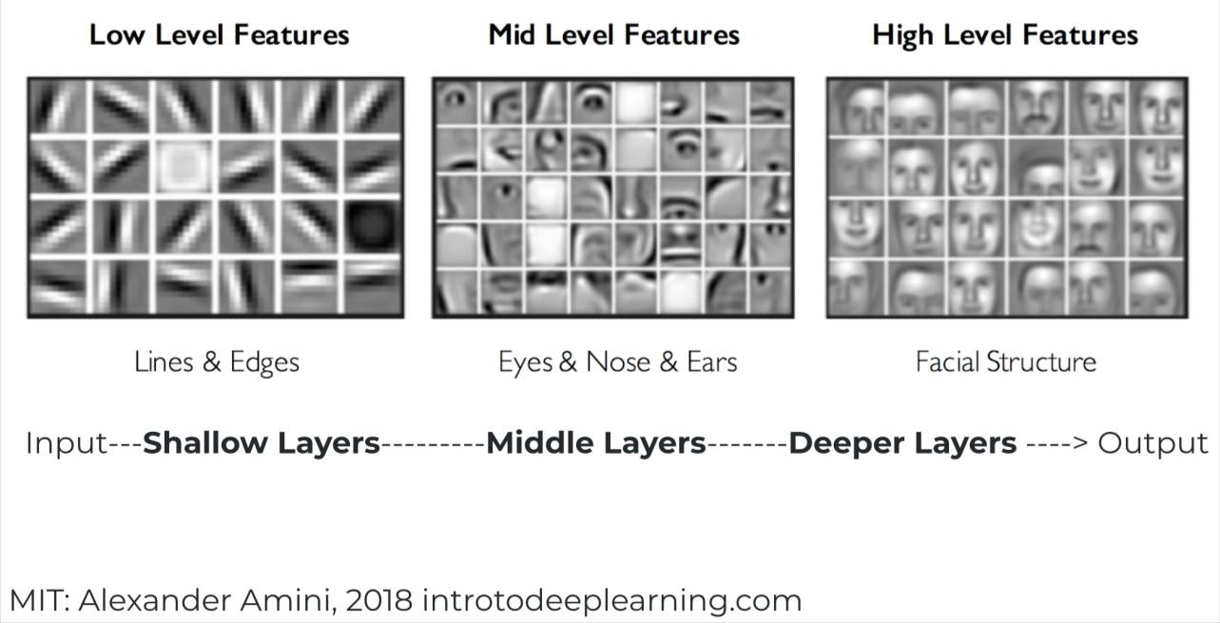
Deep vs. Shallow [Representation]
 | Deep methods | Shallow methods
Feature space | Expressive new space | Primitive space
Loosing semantic information

Slide 15
Deep vs. Shallow: [Algorithm Type]
 | Deep methods | Shallow methods
Feature space | Expressive new space | Primitive space
Anomaly detection algo. | Defined by NN structure | Heuristic or ad hoc

Slide 16
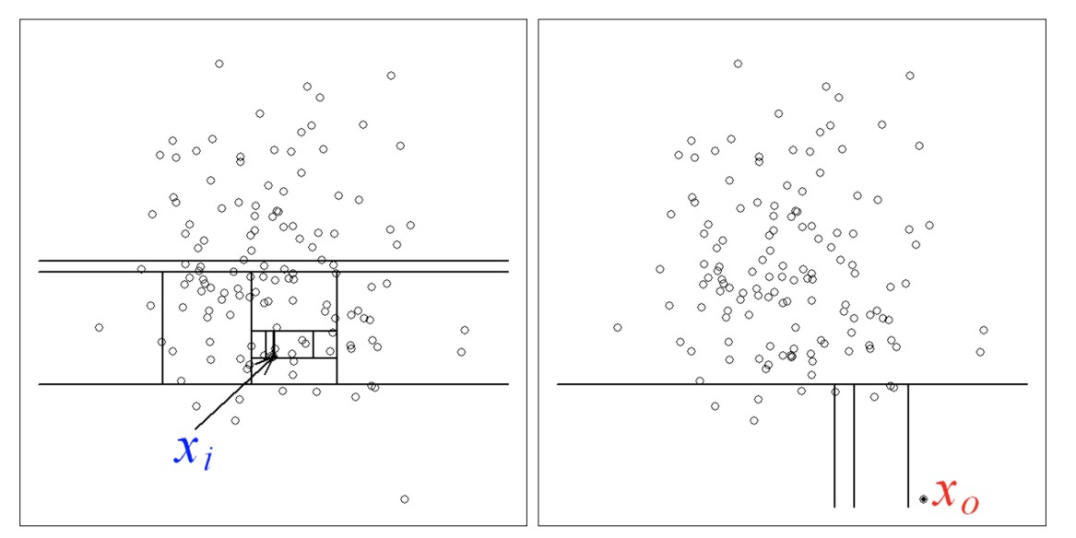
Deep vs. Shallow [Feature Relations]
 | Deep methods | Shallow methods
Feature space | Expressive new space | Primitive space
Anomaly detection algo. | Defined by NN structure | Heuristic or ad hoc
Feature relations captured | Intricate | Simple

Slide 17
Deep vs. Shallow [Feature Learning Methods for Diverse Data Types]
 | Deep methods | Shallow methods
Feature space | Expressive new space | Primitive space
Anomaly detection algo. | Defined by NN structure | Heuristic or ad hoc
Feature relations captured | Intricate | Simple
Extracting features in diverse types of data | Varying on architectures and loss functions [e.g., RNN, CNN] | Hand-crafted feature extractors/off-the-shelf methods
MLP, CNN, RNN, GNN, etc. vs. random projection, PCA, subgraph patterns, optical flow, etc.

Slide 18
Deep vs. Shallow Methods [Localization]
 | Deep methods | Shallow methods
Feature space | Expressive new space | Primitive space
Anomaly detection algo. | Defined by NN structure | Heuristic or ad hoc
Feature relations captured | Intricate | Simple
Extracting features in diverse types of data | Varying on architectures and loss functions [e.g., RNN, CNN] | Hand-crafted feature extractors/off-the-shelf methods
Unified anomaly detection and localization | Yes | No

Slide 19
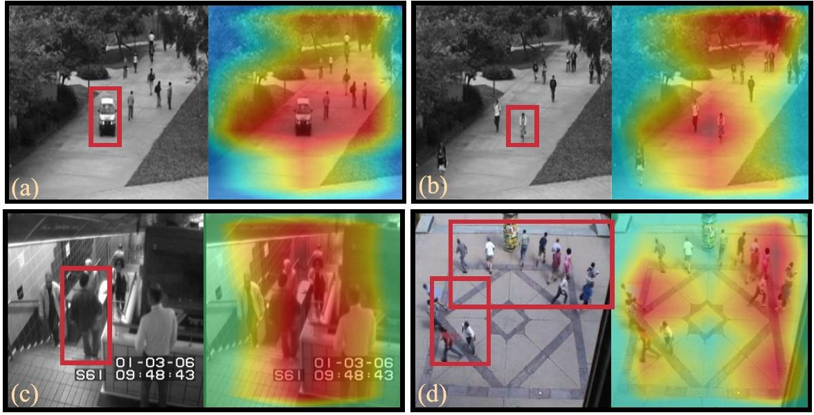
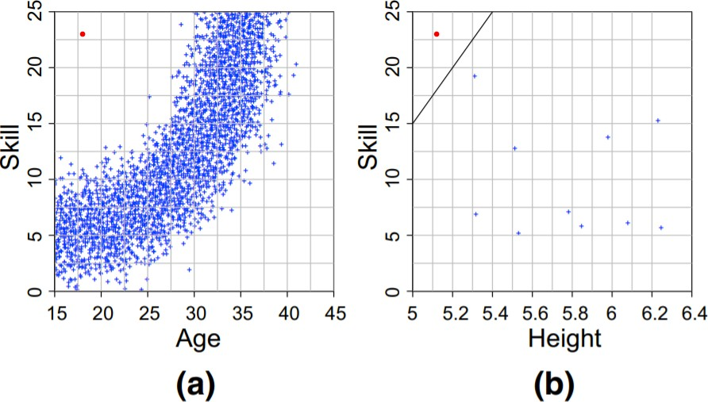
Deep vs. Shallow Methods [Localization]
Anomaly scores → backpropagating to obtain activation maps
Model-independent outlying aspect mining
Pang, Guansong, et al. "Self-trained deep ordinal regression for End-to-End video
anomaly detection.“ In: CVPR. 2020.
Angiulli, Fabrizio, et al. "Outlying property detection with numerical
attributes." Data mining and knowledge discovery 31.1 (2017): 134-163.

Slide 20
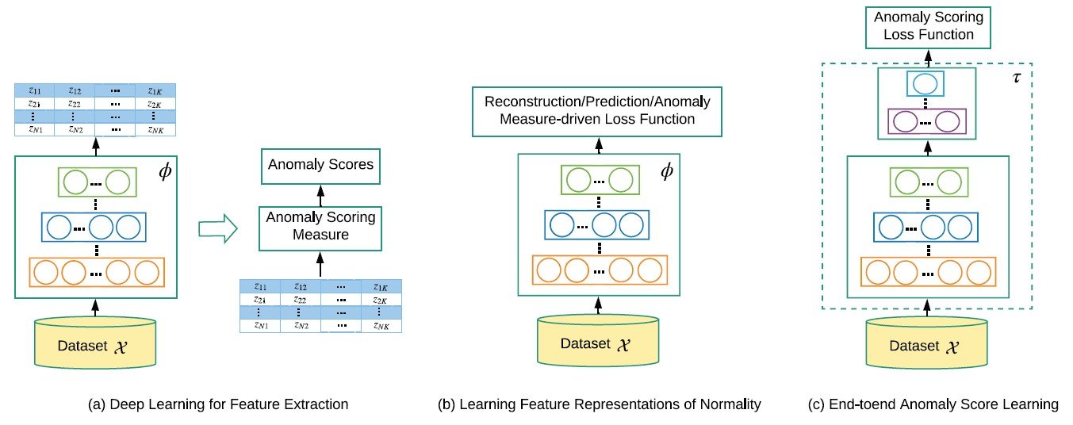
Three Principal Categories
End-to-end optimization of
pipeline with score learning
Anomaly detection-specific feature learning
Simplest approaches
Most methods belong to this category,
e.g., autoencoder-, GANs-, one-class models
Often more effective than the
other two approaches
Pang, Guansong, et al. Deep learning for anomaly detection: A review. ACM Computing Survey

Slide 21
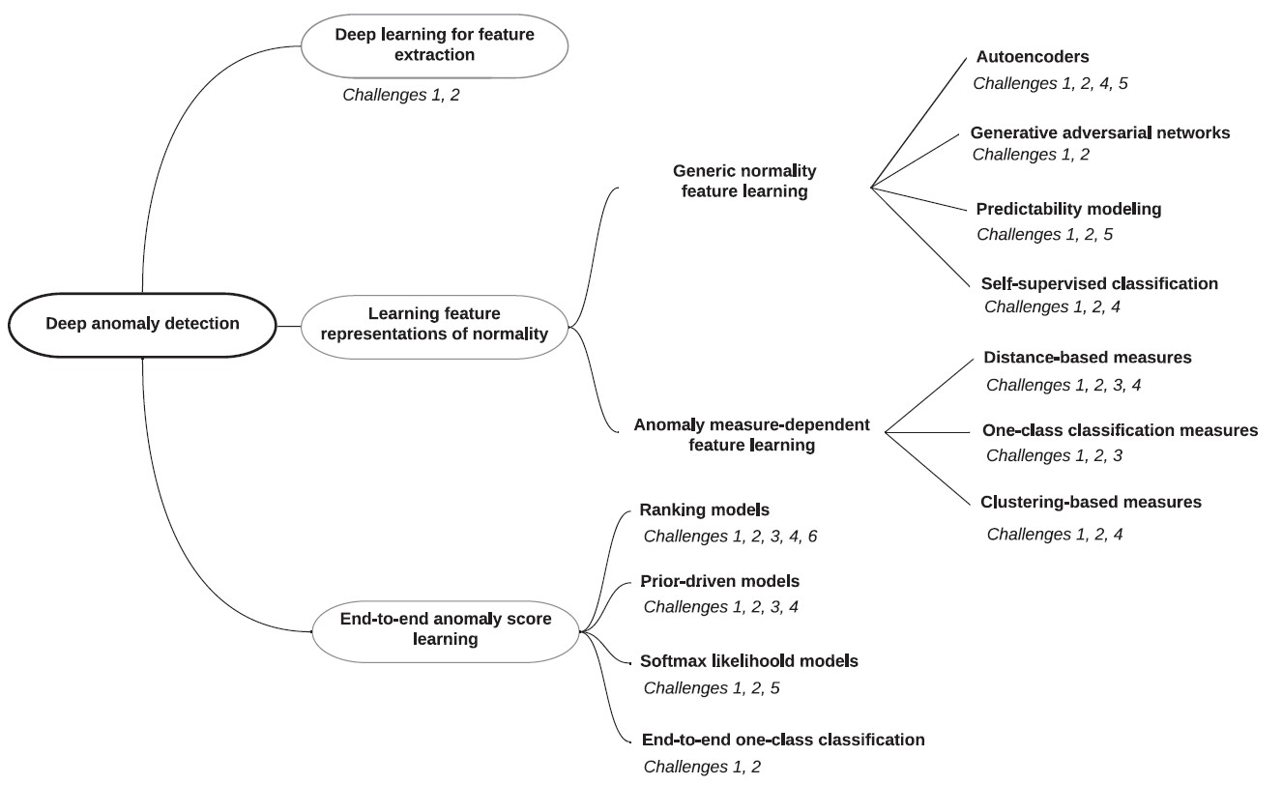
More Detailed Taxonomy
Three high-level categories of methods and 11 fine-grained subcategories of methods

Slide 22
Categorization Based on Supervision
Unsupervised approach
Working on anomaly-contaminated unlabeled data; no manually labeled training data
Limited work done
Semi-supervised approach
Assuming the availability of a set of manually labeled normal training data
Most of current deep methods belong to this approach
Weakly-supervised approach
Assuming we have some labels for anomaly classes, yet the class labels are partial (i.e., they do not span the entire set of anomaly class), inexact (i.e., coarse-grained labels), or inaccurate (i.e., some given labels can be incorrect)
Limited work done

Slide 23
Supervision: Application Settings
Unsupervised: Too costly to collect normal data or anomalies
Health monitoring, unusual observation discovery in natural science research, etc.
Semi-Supervised: Lots of normal data obtained easily
Video surveillance, visual defect detection.
Weakly Supervised: A few manually labeled anomalies easy to obtain
Fraud detection, intrusion detection, disease detection

Slide 24
Part 2: Methods
The modeling perspective
Deep learning for feature extraction
Learning feature representations of normality
End-to-end anomaly score learning
The supervision information perspective
Unsupervised approach
Weakly-supervised approach
Semi-supervised approach
Implementation and Evaluation

Slide 25
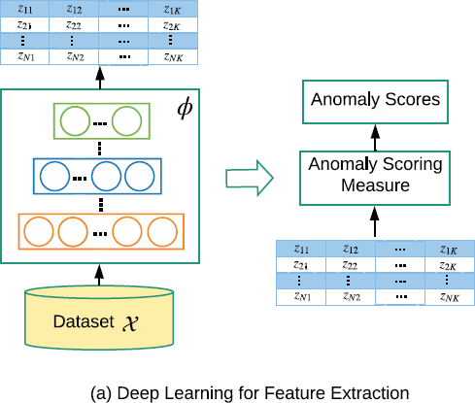
Deep learning for feature extraction
Leveraging existing deep models to extract low dimensional features for downstream anomaly measures
-
The feature extraction and the anomaly scoring are fully disjointed
Assumption: the extracted features preserve the discriminative information that helps separate anomalies from normal instances
Working purely as
feature extraction
General framework
1. Given dataset 𝓧 =
formulated as
𝒙₁, 𝒙₂, ⋯ , 𝒙_{𝑁} 𝑤𝑖𝑡ℎ 𝒙_{𝒊} ∈ ℝ^{𝐷}, the approach is
𝒛 = 𝜙(𝒙; Θ)
where 𝜙: 𝑌 → 𝒵 is a deep-neural-network-based feature mapping,
with 𝒵 ∈ ℝ^{𝐾} (𝐾 ≪ 𝐷)
2. An anomaly measure, i.e., 𝒇 that has no connection to 𝝓, is then
applied onto the new space to calculate anomaly scores
Two directions: pre-trained models vs directly training deep feature extractors on the target data

Slide 26
Using pre-trained models
General framework
Pre-trained deep
models
1. First use a pre-trained network 𝝓 such as AlexNet, VGG, and ResNet to extract low- dimensional features 𝒛
2. Then apply an anomaly measure 𝒇 to
calculate the anomaly scores
Applications
This approach is commonly used in image or
video anomaly detection

Slide 27
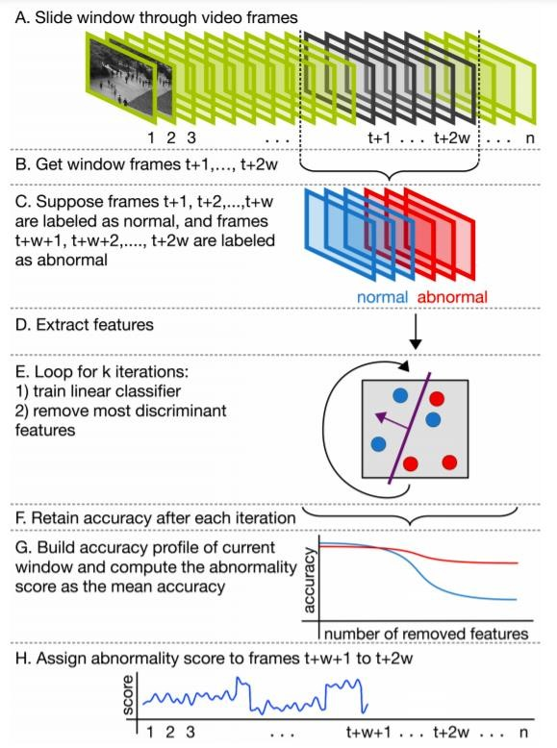
Example: VGG + Unmasking
Intuition
Abnormal video frames are more distinguishable than normal video frames when compared with adjacent frames
The model
Two sets of video frames {t-w, …, t} vs. {t+1,…,t+w}
The VGG model is used to extract features from these
video frames
Iteratively train a binary classifier to distinguish these two video sets while removing at each step the most discriminant features (anomalous to unmasking)
Mean training classification accuracy as anomaly score
VGG model
Tudor Ionescu, Radu, et al. "Unmasking the abnormal events in video.“ In: ICCV. 2017.

Slide 28
Training deep feature extraction models
General framework
First training a network 𝝓 such as autoencoders to extract low-dimensional features 𝒛
Then apply an anomaly measure 𝒇 to calculate the
anomaly scores
Applications
Autoencoder is commonly used to instantiate the neural
network mapping 𝝓
Autoencoder (𝝓) + one-class SVM (𝒇) [Xu et al., BMVC 2015]
Autoencoder (𝝓) + clustering (𝒇) [Yu et al., KDD 2018]
Autoencoder (𝝓) + unsupervised classification (𝒇) [Ionescu et al. CVPR 2019]
Learning deep feature extractors using training data
Tudor Ionescu, Radu, et al. "Object-centric auto-encoders and dummy anomalies for abnormal event detection in video.“ In: CVPR. 2019.
Xu, Dan, et al. "Learning deep representations of appearance and motion for anomalous event detection.“ In: BMVC (2015).
Yu, Wenchao, et al. "Netwalk: A flexible deep embedding approach for anomaly detection in dynamic networks.“ In: KDD. 2018.

Slide 29
Section summary
Pros
Many state-of-the art (pre-trained) deep models and off-the-shelf anomaly detectors are readily available
More powerful dimensionality reduction
than popular linear methods
Easy-to-implement
Cons
Fully disjointing feature extraction and anomaly scoring can lead to significant loss of anomaly-discriminative information
Pre-trained deep models are typically
limited to specific types of data
Inherent limitation of existing anomaly measures

Slide 30
Part 2: Methods
The modeling perspective
Deep learning for feature extraction
Learning feature representations of normality
End-to-end anomaly score learning
The supervision information perspective
Unsupervised approach
Weakly-supervised approach
Semi-supervised approach
Implementation and Evaluation

Slide 31
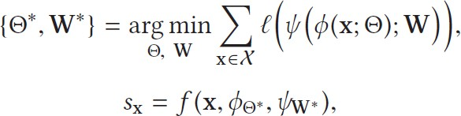
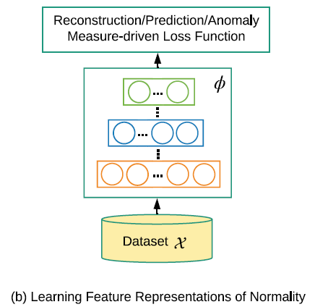
Learning feature representations of normality
Integrating feature learning with anomaly scoring in some ways, rather than fully decoupling them as in approach I
Adapting popular deep approaches for normality feature learning
(𝜓 is a surrogate feature learning function, ℓ is a loss function)
e.g., autoencoder methods
𝝓 – encoder, 𝝍 – decoder, 𝒇 – a reconstruction error-based anomaly score

Slide 32
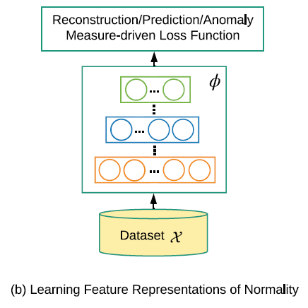
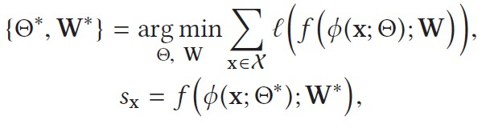
Learning feature representations of normality
Integrating feature learning with anomaly scoring in some ways, rather than fully decoupling them as in approach I
Adapting popular deep approaches for normality feature learning
(𝜓 is a surrogate feature learning function, ℓ is a loss function)
Anomaly measure-dependent feature leaning
𝑓 is a traditional anomaly measure, e.g., one-class measure, the nearest neighbor distance

Slide 33
Taxonomy: the modeling perspective
Three high-level categories of methods and 11 fine-grained subcategories of methods
35

Slide 34
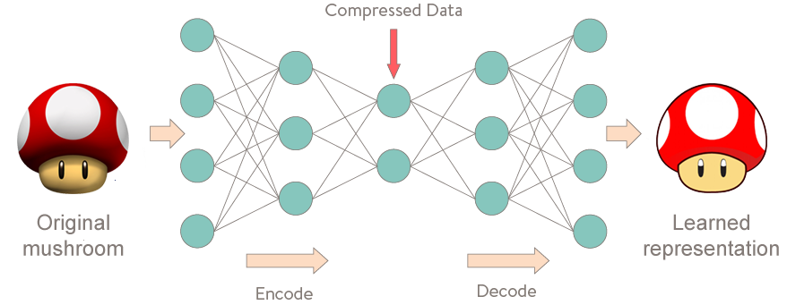
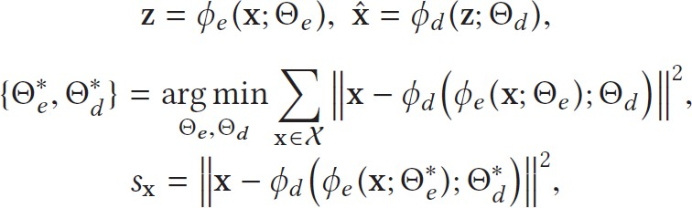
Autoencoders
To learn some low-dimensional feature representation space on which the given data instances can be well reconstructed
Assumption: Normal instances can be better reconstructed from compressed feature space than
anomalies
General Framework
Bottleneck architecture + reconstruction loss
The larger reconstruction errors the more abnormal
objective
score

Slide 35
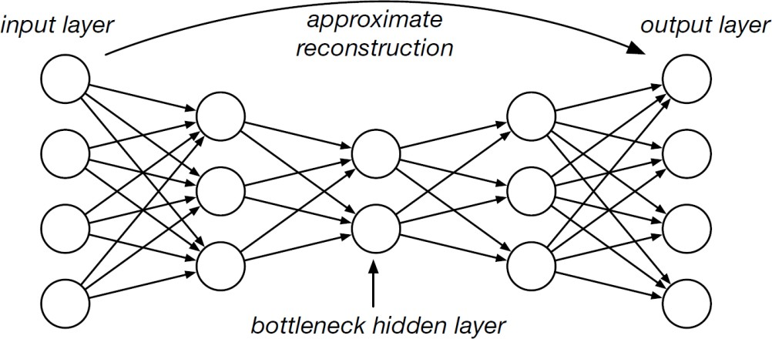
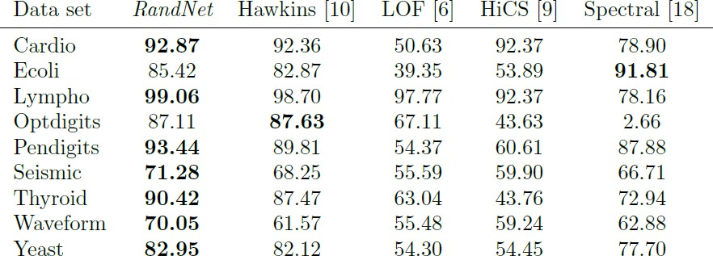
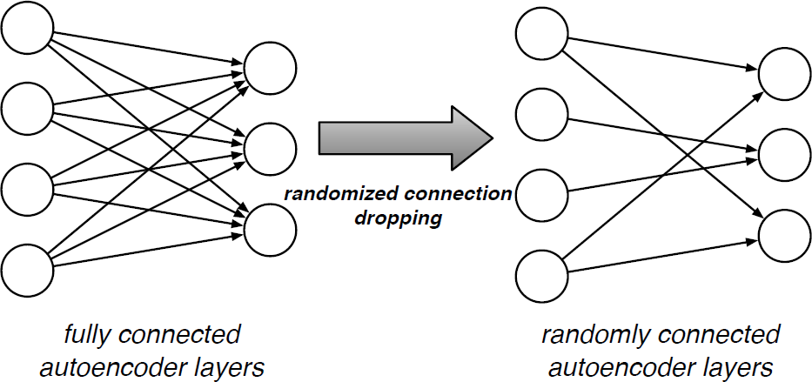
Autoencoders – ensemble method
A set of autoencoders with randomly connected dense layers
Increasing the model diversity
Empirical results on UCI datasets
Chen, Jinghui, et al. "Outlier detection with autoencoder ensembles.“ In: SDM. 2017.

Slide 36
Taxonomy: the modeling perspective
Three high-level categories of methods and 11 fine-grained subcategories of methods

Slide 37
Generative Adversarial Networks (GANs)
To adversarially learn a latent space that captures the normality underlying the given data
Assumption: Normal data instances can be better generated than anomalies from the latent
feature space of the generative network in GANs
General framework
Train a GAN-based model
Calculate anomaly scores by looking into the difference between an input instance and its
counterpart generated from the latent space of the generator

Slide 38
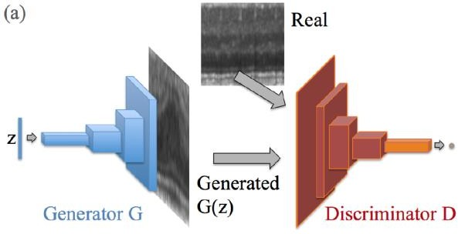
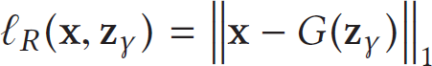
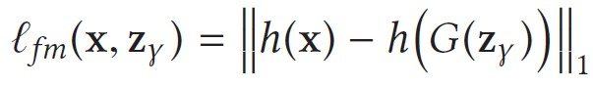
Example – AnoGAN
Intuition
Given an instance x, there is generally an instance z in the latent feature space of the generative network so that the corresponding generated instance G(z) and x are as similar as possible
The model
Train a GAN model using the standard GAN objective function
Explicitly searching for the instance z in the latent space of normality
3. Anomaly score
where h is the last feature layer of the discriminator
Schlegl, Thomas, et al. "Unsupervised anomaly detection with generative adversarial networks to guide marker discovery." In: IPMI. Springer, Cham, 2017.
Notes:
D(x) range [0,1]
Run multiple backprop steps to find best z

Slide 39
Taxonomy: the modeling perspective
Three high-level categories of methods and 11 fine-grained subcategories of methods
44

Slide 40
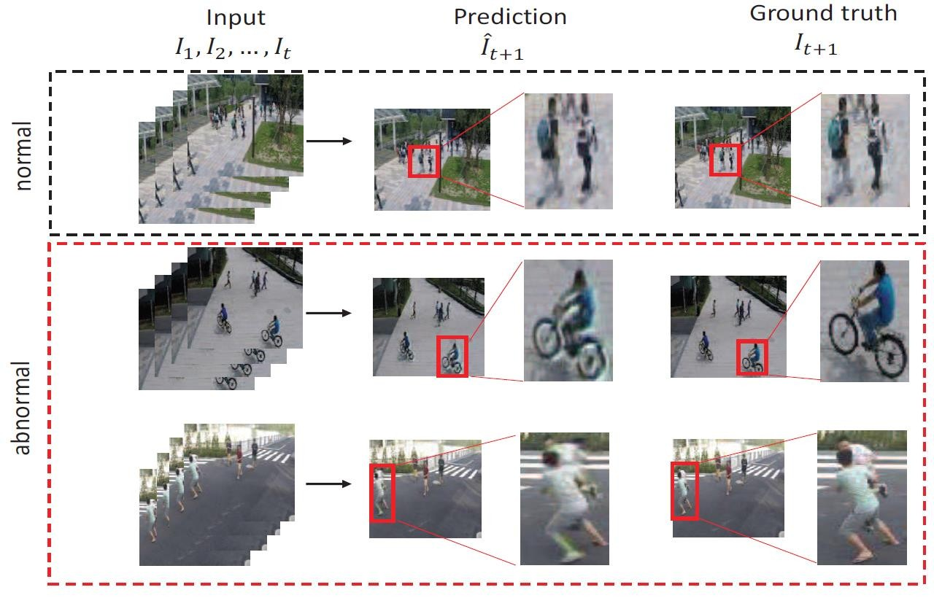
Predictability modeling
Learn representations by using temporally adjacent instances as the context to predict the current/future instances
Assumption: Normal instances are temporally more predictable than anomalies
General framework
Train a current/future instance prediction network
Calculate the difference between the predicted instance
and the actual instance as anomaly score.

Slide 41
Taxonomy: the modeling perspective
Three high-level categories of methods and 11 fine-grained subcategories of methods

Slide 42
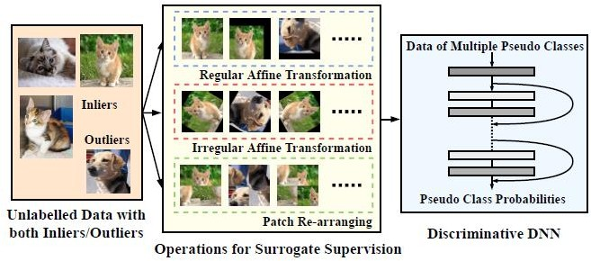
Self-supervised classification
Learn representations of normality by self-supervised classification with different data augmentation operations
Assumption: Normal instances are more consistent to self-supervised classifiers than anomalies
General framework
Apply different augmentation operations to the data
Learn a multi-class classification model using instances augmented with the same operation as one class
Calculate the inconsistency of the instance to the model
as anomaly score
Image source: Wang, Siqi, et al. "Effective End-to-end Unsupervised Outlier Detection
via Inlier Priority of Discriminative Network.“ In: NeurIPS. 2019.

Slide 43
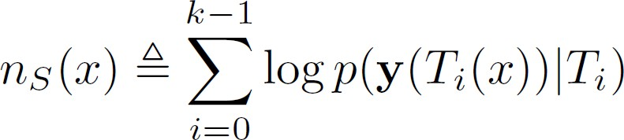
Example – Image geometric transformations
Intuition
Train a multi-class model to discriminate between dozens of geometric transformations applied on all the given images
The model
Self labeling with compositions of horizontal flipping, translations, and rotations, resulting in 72
distinct transformations
Training a 72-class deep classification model with a standard cross-entropy loss function
Using softmax statistics to calculate normality score
where 𝑇_{𝑖} is one type of composite geometric transformation
Golan, Izhak, et al. "Deep anomaly detection using geometric transformations.“ In: NeurIPS. 2018.

Slide 44
Section summary
Pros
Can leverage existing deep autoencoder/GAN/predictability modeling/self-supervised classification models for anomaly detection
The learned representations are generally more effective than the methods as in approach I
Cons
Some of the methods are limited to specific type of data
Methods like GAN/predictability modeling are computationally costly at the training stage
Most methods are sensitive to anomaly contamination; cannot work in unsupervised settings

Slide 45
Taxonomy: the modeling perspective
Three high-level categories of methods and 11 fine-grained subcategories of methods

Slide 46
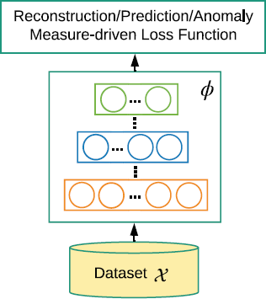
Distance-based measure
Learning representations tailored for distance-based measures
Assumption: Anomalies are distributed far from their closest neighbors while normal instances are located in dense neighborhoods
The general framework
Devise a feature mapping function 𝜙 that maps original data onto
a new representation space
Optimize the feature representations such that anomalies have larger
distance to some reference instances than normal instances
Anomaly scoring using the desired distance measure in the new space
Distance-based measure

Slide 47
Taxonomy: the modeling perspective
Three high-level categories of methods and 11 fine-grained subcategories of methods

Slide 48
One-class classification measure
Learning representations tailored for one-class classification
Assumption: All normal instances come from a single (abstract) class and can be summarized by a
compact model, to which anomalies do not conform
One-class classification measure
The general framework
1. Devise a feature mapping function 𝜙 that maps original data onto
a new representation space
Optimize the feature representations using one-class classification loss
Anomaly scoring using the one-class classification model in the new space

Slide 49
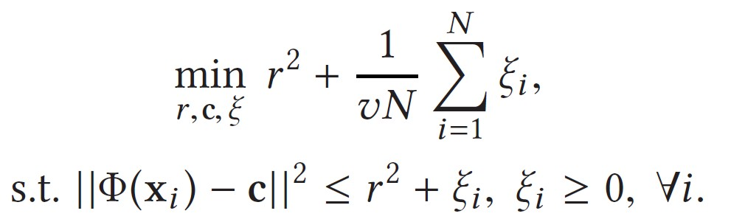
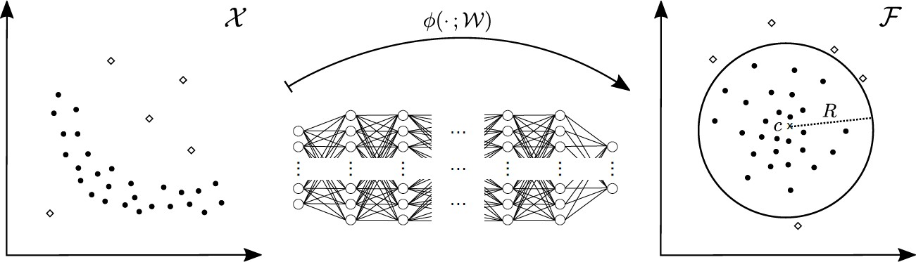
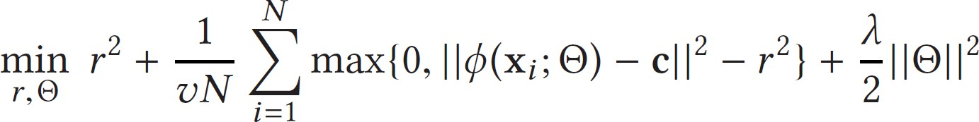
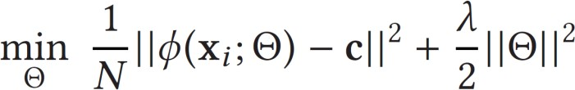
Example – Deep support vector data description (Deep SVDD)
Intuition
To learn feature representations tailored for SVDD-based anomaly detection
The model
Soft boundary
with radius r
Hard boundary
Ruff, Lukas, et al. "Deep one-class classification.“ In: ICML. 2018.

Slide 50
Taxonomy: the modeling perspective
Three high-level categories of methods and 11 fine-grained subcategories of methods

Slide 51
Cluster-based measure
Learning representations so that anomalies are clearly deviated from
the clusters in the newly learned representation space
Assumption: Normal instances have stronger adherence to clusters than anomalies
Cluster-based measure
The general framework
1. Devise a feature mapping function 𝜙 that maps original data onto
a new representation space
Optimize the feature representations using clustering-based loss
Anomaly scoring using a cluster-based anomaly measure in the new space

Slide 52
Section summary
Pros
Strong foundation from traditional anomaly measures (distance/one-class classification/cluster-based measures) in the literature
Working on low-dimensional feature representations that are specifically optimized for the anomaly measures, resulting in more effective detection
Cons
The performance of anomaly detection is heavily dependent on the specific anomaly measures - inherent limitations of the measures
The clustering process may be biased by contaminated anomalies in the training data, which in turn leads to less effective representations

Slide 53
Part 2: Methods
The modeling perspective
Deep learning for feature extraction
Learning feature representations of normality
End-to-end anomaly score learning
The supervision information perspective
Unsupervised approach
Weakly-supervised approach
Semi-supervised approach
Implementation and Evaluation

Slide 54
Part 2: Methods
The modeling perspective
Deep learning for feature extraction
Learning feature representations of normality
End-to-end anomaly score learning
The supervision information perspective
Unsupervised approach
Weakly-supervised approach
Semi-supervised approach
Implementation and Evaluation

Slide 55
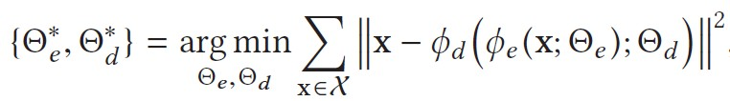
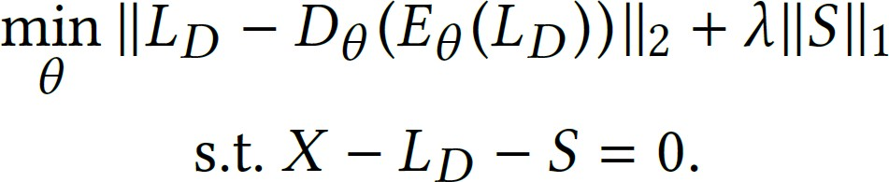
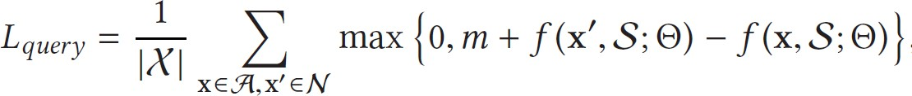
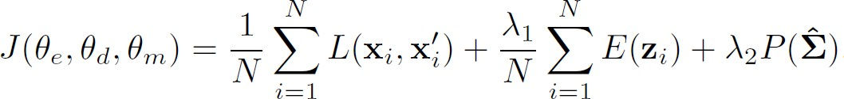
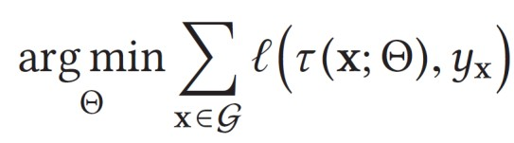
Unsupervised approach
Training on anomaly-contaminated unlabeled data
Outlier-aware autoencoders
Robust deep autoencoders (RDA-KDD17)
Pseudo labeling
Deep distance-based method (REPEN-KDD18)
One-class models, soft boundary
Deep SVDD (ICML18)
Augmented deep clustering
DAGMM (ICLR18)
Deep ordinal regression (DOR-CVPR20)

Slide 56
Part 2: Methods
The modeling perspective
Deep learning for feature extraction
Learning feature representations of normality
End-to-end anomaly score learning
The supervision information perspective
Unsupervised approach
Weakly-supervised approach
Semi-supervised approach
Implementation and Evaluation

Slide 57




Weakly-supervised approach 1/2
A limited number of partially labeled anomalies and large unlabeled data
Contrastive feature learning
Deep distance-based method (REPEN-KDD18)
Reinforcement learning*
Prior-driven method
Deviation network (DevNet-KDD19)
Surrogate learning
Pairwise relation prediction (PReNet-arXiv19)
A limited number of partially labeled anomalies +
large unlabeled data + some labeled normal data
⁺Deep SAD built upon Deep SVDD
*Pang, Guansong, et al. "Deep Reinforcement Learning for Unknown Anomaly Detection." arXiv preprint:2009.06847 (2020).
⁺Ruff, Lukas, et al. "Deep semi-supervised anomaly detection." arXiv preprint arXiv:1906.02694 (2019).

Slide 58


Weakly-supervised approach 2/2
Inexact anomaly labels (coarse-grained labels)
Multiple instance learning
Problem setting: Given a large set of videos with video-level labels of anomaly and normal classes, we aim to learn detection models to identify abnormal video frames
Positive bags
Negative bags
Tian, Yu, et al. "Weakly-supervised Video Anomaly Detection with Contrastive Learning of Long and Short-range
Temporal Features." arXiv preprint:2101.10030 (2021).
Sultani, Waqas, et al. "Real-world anomaly detection in surveillance videos.“ In: CVPR. 2018.

Slide 59
Part 2: Methods
The modeling perspective
Deep learning for feature extraction
Learning feature representations of normality
End-to-end anomaly score learning
The supervision information perspective
Unsupervised approach
Weakly-supervised approach
Semi-supervised approach
Implementation and Evaluation

Slide 60
Semi-supervised approach
Training on a large labeled normal
dataset
All methods in the category
Many methods in the category

Slide 61
Part 2: Methods
The modeling perspective
Deep learning for feature extraction
Learning feature representations of normality
End-to-end anomaly score learning
The supervision information perspective
Unsupervised approach
Weakly-supervised approach
Semi-supervised approach
Implementation and Evaluation

Slide 62

Implementation of representative algorithms

Slide 63

Source codes of representative algorithms

Slide 64

Publicly available datasets with real anomalies
Collection of continuously updated preprocessed datasets is made available at
https://github.com/GuansongPang/anomaly-detection-datasets

Slide 65
Part 3: Conclusions and future opportunities
Summary of the methods
PINlab research
65

Slide 66
Summary of the methods
AutoEncoder Distance-based Measures Ranking Models Prior-driven Models
ID | Challenge | FE | AE | GAN | PD | SC | DM | OCM | CM | RM | PM | SLM | EOC
CH1 | Low detection recall | √ | √ | √ | √ | √ | √ | √ | √ | √ | √ | √ | √
CH2 | Handling complex data | √ | √ | √ | √ | √ | √ | √ | √ | √ | √ | √ | √
CH3 | Data-efficient learning |  |  |  |  |  | √ | √ |  | √ | √
CH4 | Noise-resilient |  | √ |  |  | √ | √ |  | √ | √ | √
CH5 | Complex anomalies |  | √ |  | √ |  |  |  |  |  |  | √
CH6 | Anomaly explanation |  |  |  |  |  |  |  |  | √
66

Slide 67
Part 3: Conclusions and future opportunities
Summary of the methods
PINlab research
67

Slide 68


HypAD - Hyperbolic Uncertainty for Anomaly Detection
Built on the current best (TADGAN^{[1]})
Reconstruction error via Encoder-Decoder
2 critics for adversarial training (original Vs reconstructed in input $D_{x}$ and embedding space $D_{z}$)
Measure reconstruction error in Hyperbolic space
Map the original $x$ and the reconstructed signal $G(E\left(x\right))$ into the Poincaré ball via exponential mapping [Ganea et al. NeurIPS’18]
Distances of hyperbolic embeddings ${\left\|\tilde{h}\right\|}^{2}$ from the origin define (un)certainty:
68

Slide 69

Uncertainty
Handshake or High Five?
At least we can say they are greeting each other
69

Slide 70

COSKAD
Force “normality” to a hypersphere, w/ space curvatures
Euclidean (c=0)
Hyperbolic (c=-1)
Radial (c=1)
Estimate and track poses with AlphaPose and PoseFlow
Encode space-time body kinematics by STS-GCN^{[2]}
Project to latent space
by DSVDD^{[1]}
^{[1]} Ruff et al. ICML’18, “Deep One-Class Classification”
^{[2]} Sofianos et al. ICCV’21, “Space-Time-Separable Graph Convolutional Network for Pose Forecasting”

Slide 71



Latent Spaces
One Class Classification Problem
Learning normality
from train set
Abnormalities pushed far
from the center
Euclidean
Euclidean Distance
Radial
Cosine Distance
Hyperbolic
Poincarè Distance

Slide 72

The end
72

